Slide 1

Computer Peripherals & Interfacing Project: Smart Home Automation System Presented By Team ZeroSplash
Supervised By Presented By
Tanvir Ahammad Shabikun Nahar(B190305013)
Lecturer &
Department of CSE Md. Sakibul Islam(B190305035)
Jagannath University. Department of CSE
Jagannath University.

Slide 2
Table of Contents
Introduction
Purpose of the Project
Features
Methodology
Implementation
Conclusion
References

Slide 3
Introduction
Automation is the use of machine control systems and information technologies to optimize productivity in producing goods and delivering services.
Automating the home helps save electricity, reduces manual labor increases reliability and efficiency.
This project demonstrates how to design and build a multipurpose remote-control and also by smartphone system that can switch electric household appliances (including fan and light) off and on using Google Assistant interfaced via ESP8266.

Slide 4
Purpose of the Project
To implement a low-cost, reliable, and scalable home automation system.
Remotely switch off or on any household appliance.
To achieve hardware simplicity, timer feedback, temperature controller to turn off on the device, and voice dial from any phone to toggle the switch state.

Slide 5
Features & Tools
Voice Control
Lighting Automation
Fanning Automation
Timer Automation
Temperature Automation
Remote Control
NodeMCU ESP8266
4-channel 5V SPDT Relay Module
DHT11 temperature sensor
Switches or pushbuttons
Electric appliances bulbs and fan
Jumper cables

Slide 6
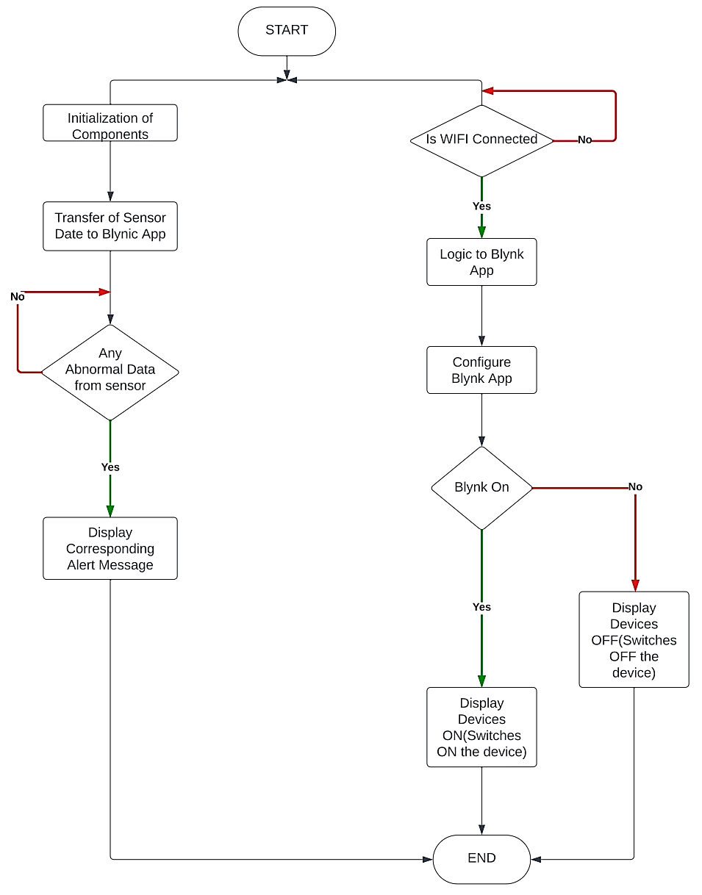
Methodology

Slide 7
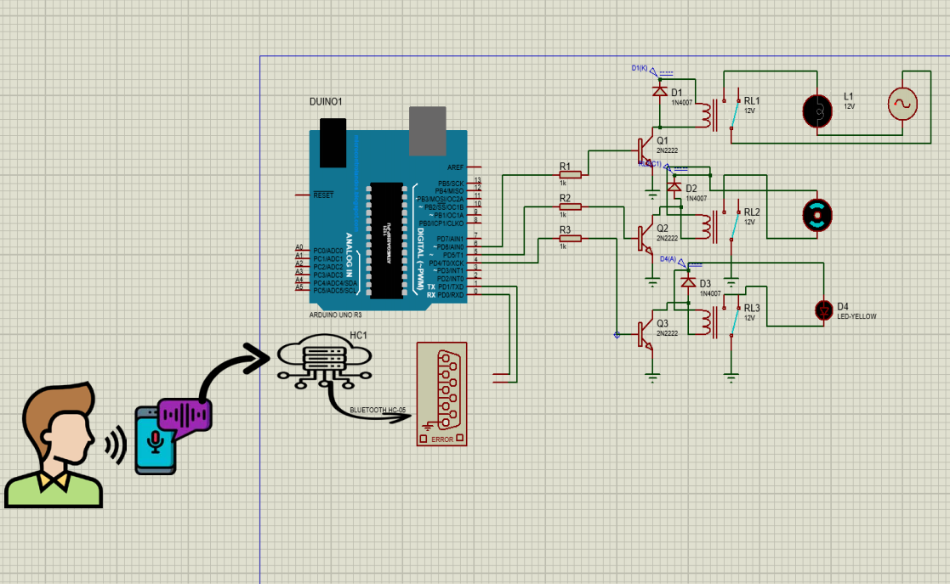
Working Module

Slide 8
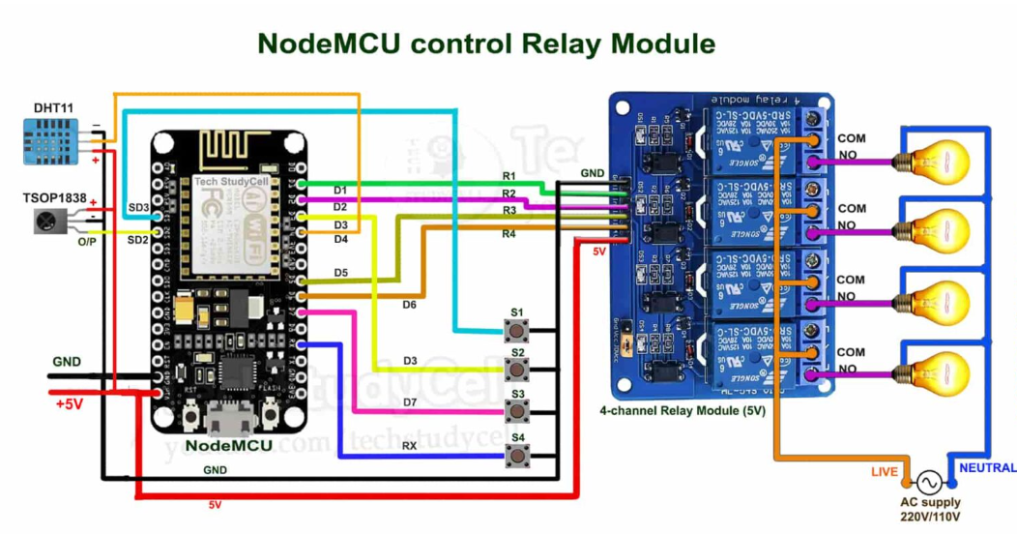
Implementation Module

Slide 9
Implementation
Step 1: Connect Everything as Circuit Diagram of the ESP32 Project
The circuit is very simple, we have used D1, D2, D5 & D6 GPIO pins to control the 4-channel relay module.
And the GPIO SD3, D3, D7 & RX are connected with the switches to control the relay module manually.
I have used the INPUT_PULLUP function in Arduino IDE instead of using the pull-up resistors with each push button.
As per the source code, when the control pins of the relay module receive a LOW signal the relay will turn on and the relay will turn off for the HIGH signal in the control pin.
If you want to use the pushbuttons instead of latched switches, then just connect the pushbuttons instead of the latched switches across GPIO pins and GND.

Slide 10
Implementation
Step 2: Control Relays With Internet Using Blynk
If the ESP32 module is connected with the WiFi, then you can control the home appliances from Blynk App and push buttons.You can control, monitor the real-time status of the relays from anywhere in the world with the Blynk App.
Step 3: Control Relays Without Internet Using Push-buttons
The ESP32 will check for the WiFi after every 3 seconds. When the WiFi is available, the ESP32 will automatically connect with the WiFi.

Slide 11
Step 4: Configure the Blynk App for the ESP32
The ESP32 will check for the WiFi after every 3 seconds. When the WiFi is available, the ESP32 will automatically connect with the WiFi.
1. Install the Blynk App from the Google play store or App store. Then create an account and tap on the New Project.
2. Give the name of the project, select ESP32 Dev Board, Connection type will be WiFi. Then tap on Create.
3. Blynk will send an authentication token to the registered email ID. Tap on OK.
Step 5: Add the Button Widgets in the Blynk App

Slide 12
Step 6: Code for Blynk ESP32 Home Automation
Then add 4 button widgets to control the 4 relays. Here I have used virtual pins V1, V2, V3, V4 for 4 buttons. And mode will be Switch.
Step 7: Program the ESP32 With Arduino IDE
While uploading the code to ESP32, if you see the "Connecting....___" text, then press the BOOT button of the ESP32.

Slide 13
Step 14: Connect the Home Appliances
After uploading the code, if the ESP32 connects with the WiFi, the blue LED will turn on. Then you can control the relay module from the Blynk App and push-button. Connect the 8 home appliances as per the circuit diagram. Please take proper safety precautions while working with high voltage.
Step 15: Turn ON the Supply
Step 16: Finally!!
Connect the 5-volt DC supply. Turn on the 110V/230V supply and 5V DC supply.

Slide 14
Implementation Video
Link :
https://youtu.be/NC-j6BA_e4w

Slide 15
Referrences
[1] Monika M Patel; Mehul A Jajal; Dixita B vataliya, Home Automation using Raspberry Pi. International Journal of Innovative and Emerging Research in Engineering Volume 2, Issue 3, 2015.
[2] Internet of Things in Home Automation and Energy Efficient Smart Home Technologies Simon G. M. Koo Department of Computer Engineering, Santa Clara University, CA 95053, USA.

Slide 16
Thank you

